Slide 1
Team Recommendation System
Harshil Mehta
AU1841010
Btech ICT | SEM-6
Subject : Algorithms & Optimization for Big Data

Slide 2
Overview
The project topic is Project Team Recommendation System. The main requirement / purpose for this project is to distribute the members (data) in teams & evenly form teams.
We have input data in the form of skills of respective student. Our task is to match the skill accordingly and create balanced teams.
The system would ease the labour of tedious manual work of matching the candidates to their teams whilst being unbiased.

Slide 3
Approach
Here, for the simplicity of the system, I have generated random dataset with proper parameters & used the skills of the candidates as the features of the model.
Then, I have trained the model using BIRCH clustering model & clustered the data in several groups using model.predict().
Finally, I grouped them picking from each cluster & forming into given group teams.
Using the pred list, separating the cluster to form teams.

Slide 4
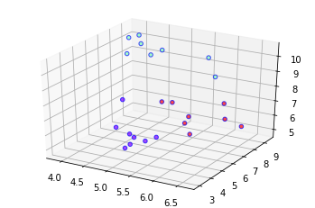
Output Clusters
Here, the 3 axis are the 3 features of the model which are the 3 skills.
Programming language grip
Algorithmic grip
Soft-skills (Vocal + Documentation)
The dots are the 3D representation of candidates having the skills are their coordinates.

Slide 5
Tech References
For developing this project, I’ve used python. Also used some libraries like sklearn to generate datasets & make data clusters.
I’ve used BIRCH clustering technique to train my model.
Some references :
https://dl.acm.org/doi/10.1145/235968.233324
https://machinelearningmastery.com/clustering-algorithms-with-python/
https://towardsdatascience.com/machine-learning-birch-clustering-algorithm-clearly-explained-fb9838cbeed9

Slide 6
Thank You!

